Slide 1

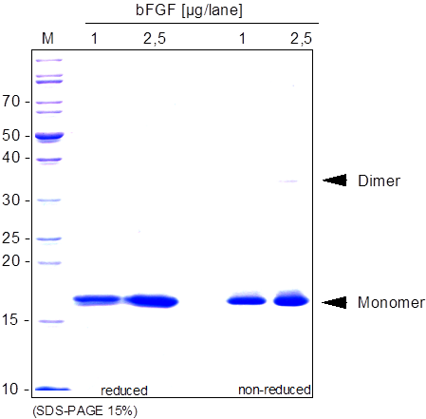
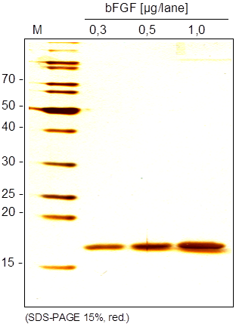
ReliaTech GmbH
Recombinant human FGF-2 (basic)
(Cat #300-001 / 300-002 / 300-003)
Fig. 1: SDS-PAGE analysis of recombinant human FGF-2 (basic) derived from E. coli. Samples were loaded in 15% SDS-polyacrylamide gel under reducing and non-reducing conditions and stained with Coomassie blue.
Fig. 2: SDS-PAGE analysis of recombinant human FGF-2 (basic) derived from E. coli. Samples were loaded in 15% SDS-polyacrylamide gel under reducing conditions and stained with Silver stain.
http://www.reliatech.de / orders@reliatech.de

